Slide 1


A LEAP INTO THE FUTURE
Improving Physician Decision-Making & Patient Outcomes Using Analytics

Slide 2
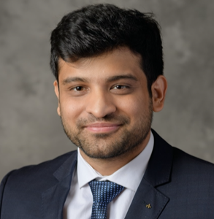



Our Team
ANISH PAHWA
SHIKHAR JAMUAR
VARUN SINGH
STUDENT CONSULTANT
STUDENT CONSULTANT
STUDENT CONSULTANT
pahwaa@purdue.edu
sjamuar@purdue.edu
singh675@purdue.edu
in
linkedin.com/in/anish-pahwa/
in
linkedin.com/in/shikhar-jamuar/
in
linkedin.com/in/varun-singh26/
(765) 775-0815
(765) 775-0817
(765) 775-0817

Slide 3
Agenda
01
Introduction
02
Objective
03
Data Understanding
04
Analysis Assumptions
05
Exploratory Analysis
06
Statistical Modeling
07
Business Insights
08
Recommendations
09
Future Scope

Slide 4

BUSINESS UNDERSTANDING

Slide 5

INTRODUCTION
525 %
5%
of the overall surgeries developed
complications.
expected increase in the number of knee surgeries by 2030
1 of 5 who undergo a knee surgery are dissatisfied with the results.
Improving Physician Decision-Making & Patient Outcomes Using Analytics

Slide 6

Objective
Business Problem
Improve physician decision making and predict Total Knee Arthroplasty surgery outcomes
Scope Of Project
1
What is the probability that a person who has undergone a knee surgery will develop complications in the future?
2
What are the drivers for good or poor post knee surgery outcomes?
Improving Physician Decision-Making & Patient Outcomes Using Analytics

Slide 7
DATA UNDERSTANDING

Slide 8
Data Understanding
Tables
Patient demographics
Surgery details
Complication
Insurance billing codes
We have used a database recorded by world’s leading knee replacement surgeon with an experience of 10000⁺ knee replacement surgeries over past 20 years.
400⁺
Variables
Sex, Height, Weight, Date of Birth, State, Smoke, Blood Pressure
CPTCode, DoctorId, modifier
ICDCode, Post-op visits, Revision Surgery
Insurance billing codes
Improving Physician Decision-Making & Patient Outcomes Using Analytics

Slide 9

Data Understanding
We have used a database recorded by world’s leading knee replacement surgeon with an experience of 10000⁺ knee replacement surgeries over past 20 years.
10 Tables
6K+ Observations
400+ Parameters
400+ Tables
Improving Physician Decision-Making & Patient Outcomes Using Analytics

Slide 10





Data Cleaning and Pre-Processing
Joining multiple patient tables
Parsing through all the CPT codes and keeping rows with relevant CPT codes
Removing duplicate Patient Profile IDs to get unique 6K+ rows
Removing rows with null values or imputing null values using decision tree
Dummy encoding for categorical variables
Improving Physician Decision-Making & Patient Outcomes Using Analytics
Notes:
Revision Surgeries- (Profile IDs having CPT codes for a revision surgery)
Side of leg- Left or Right (dummy variable)
BMI- using height and weight

Slide 11

Important Derived Variables
Derived from:
Derived from:
Date of surgery and date of birth (their difference)
BMI
Height and weight data
AGE
OUTCOME
POST OP VISITS
U
Derived from:
Derived from:
Post op visits, direct complications using ICD Codes, revision surgery
Visits table using CPT codes
Improving Physician Decision-Making & Patient Outcomes Using Analytics

Slide 12
ASSUMPTIONS

Slide 13
Assumption
Rational
Removed cases where 1st surgery was revision surgery
Cases where first surgery was not performed at Bonutti Clinic
Any revision surgery corresponds to the previous primary surgery if modifier is not given
Next primary surgery can not be performed until all revision surgeries are completed for previous surgery
Only the last visit before any surgery would be counted as pre-op visit
If there are multiple surgeries for a person, all visits but the last one would be counted as post-op visits for the previous surgery
A surgery is a failure if number of post-op visits exceeds six
We considered three or more post-op visits as a marker for failure. We found that more than 40% of the surgeries were marked as failures
Improving Physician Decision-Making & Patient Outcomes Using Analytics

Slide 14

EXPLOTARY DATA ANALYSIS

Slide 15
Patients with high Blood Pressure are twice as likely to have surgery failure compared to others
Improving Physician Decision-Making & Patient Outcomes Using Analytics

Slide 16
Difference in Failure Rate of surgeries performed by doctors
Failure Rate of surgeries by patients’ financial class
20%
Max
11%
Average
7%
Minimum
Improving Physician Decision-Making & Patient Outcomes Using Analytics

Slide 17

STATISTICAL MODELING

Slide 18


Well Performing Models
Although all three models performed similarly, Logistic Regression was slightly better. Further, we chose Logistic Regression for better interpretability
The data has a huge class imbalance, so using conventional model comparison metrics like accuracy did not seem to be just. Therefore we used F-1 score, which accounts for class imbalance, as a model comparison metric
Step 2
Decision Tree
Step 1
Random Forest
Logistic
F1 = 0.90
F1 = 0.93
F1 = 0.94
Improving Physician Decision-Making & Patient Outcomes Using Analytics

Slide 19



Insights from Statistical Model
Effect of Significant Parameters
A smoker is 34% more likely to have a surgery failure than a non-smoker
A BP patient is 133% more likely to have a surgery failure than a non-BP patient
The chances of a surgery failure decrease by 4% with 1-unit increase in Age
Improving Physician Decision-Making & Patient Outcomes Using Analytics

Slide 20

Confusion Matrix (Logistic Regression)
 |  | Actual
 |  | Success | Failure
Prediction | Success | 1297 | 47
 | Failure | 15 | 152
F-1 Score
Accuracy
Precision
Recall
94%
95%
82%
97%

Slide 21

BUSINESS IMPACT

Slide 22

Business Impact
A TKA surgery typically costs about $50,000 in total. Based on the data from the tables, there were approximately 650 surgeries carried out in 2016. Our model predicts two-thirds of complications accurately, therefore factoring in two-thirds of the complications requiring a revision, with rough estimates Bonutti Technologies can save about $2.16M in one year alone
Using our model, by predicting complications before they take place, we can reduce the number of complications to 3% of the total surgeries, and reduce burden on patients as well as surgeons
Improving Physician Decision-Making & Patient Outcomes Using Analytics

Slide 23
Recommendations

Slide 24




Way to Success
Low Surgery Failures
Early Warning System
Warning system for patients and doctors in cases where parameters are in the flagged range suggested by the model
Step 3
Step 2
Precaution for patients who smoke
Step 1
E.g. Possible use of blood thinners to avoid blood clots
Training Sessions
Surgeon trainings for minimizing the overall failure rate of the clinic

Slide 25

FUTURE SCOPE

Slide 26



Variables that could give useful insights in the future
Data on criterions like gait and VASP to better define success
VASP
Data on Surgery specifics like angle of cut for more realizable model
Knee X-Ray
Co-Morbid
Gait
Angle of Cut
Doctor Notes
More granular analysis for financials
Improving Physician Decision-Making & Patient Outcomes Using Analytics

Slide 27
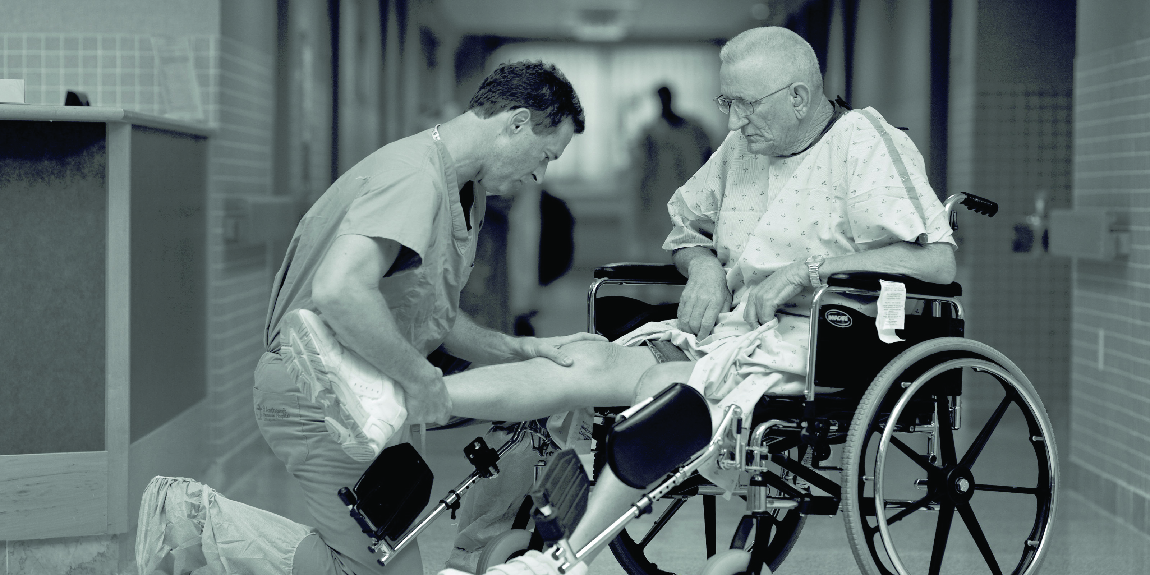
THANK YOU.

